Slide 1
Tolerance and Cooperation Among the Religious Session 06
Course : CB Pancasila
Effective Period : 2017

Slide 2
- Student will be able to analyze the issues related to tolerance inter religious - Student will be able to apply the tolerance values in their daily life
Learning Objectives

Slide 3
The Concept of Tolerance
Etymologically, the word tolerance comes from the word tolerare (Latin) which means letting.
In terminological, tolerance means patience to let other people have different opinions , different positions, different goals, different tribes , different religions , etc .

Slide 4
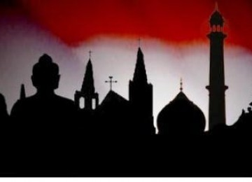
New Webster Dictionary : tolerance is given freedom ( let ) everyone else believes or apply patient in dealing with others .
Tolerance will create a harmonious relationship between humans.

Slide 5
Tolerance as the Basic of Inter Religious Cooperation
The prophet taught us unity and peace
There are commands to maintain good relations with other religions
There is no compulsion to believe a religion
We must do justice to any religion

Slide 6
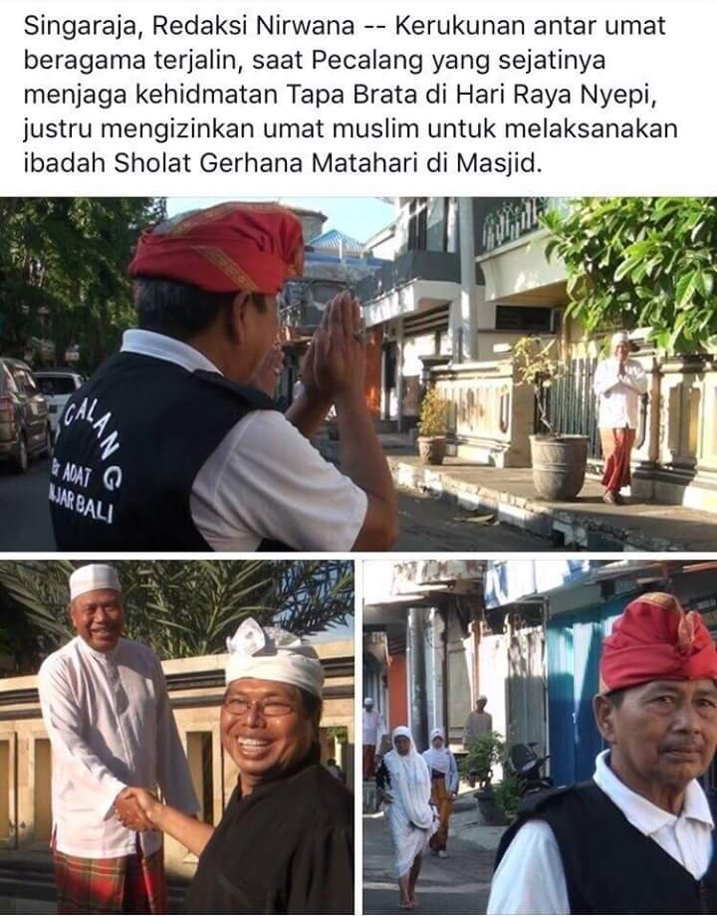
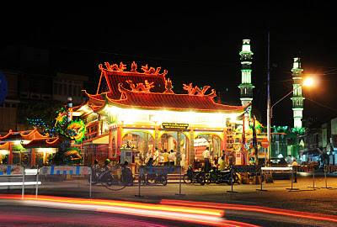
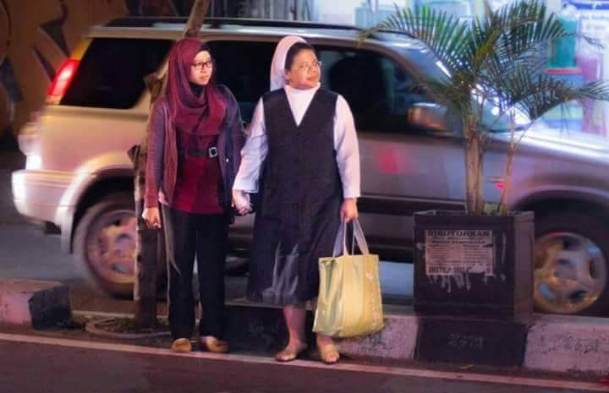

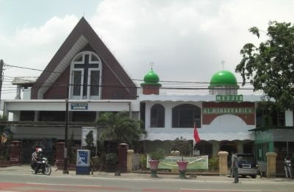
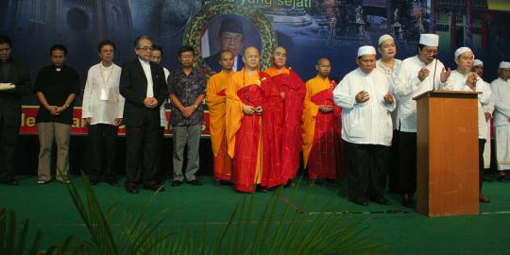

Slide 7
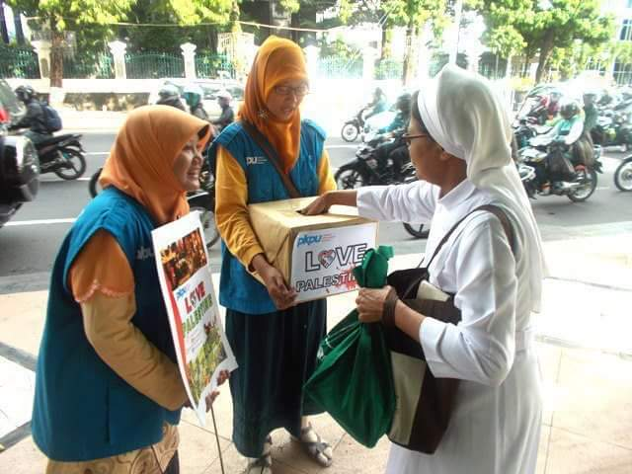
Building Inter Religion Cooperation
Religious tolerance can be built through interfaith dialogue.
Dialogue makes us understand the attitude of tolerance and harmony
Dialogue is expected to produce harmony among religious believers

Slide 8
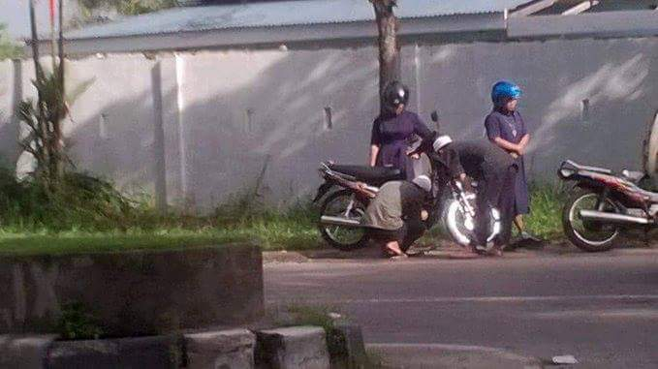
We are not strong enough when working individually
The fields of cooperation :
- Enforcement of justice
- Improving the standard of living (economy )
- Morals improvement

Slide 9
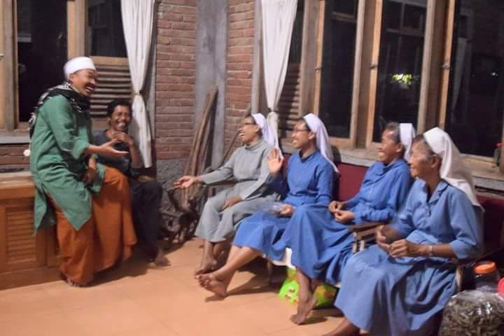
The Model of Dialogues as A Practice of Tolerance
Everyday Life Dialogue.
Social Work Dialogue
Spiritual Experience Dialogue
Theological Views Dialogue

Slide 10
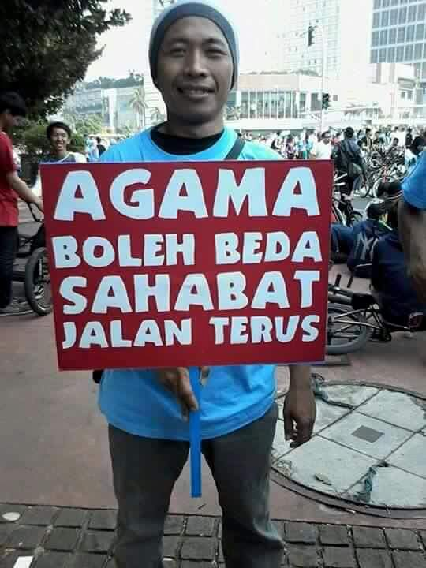
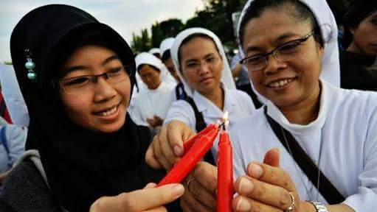
Discussion
What would you do to maintain tolerance and cooperation between religious communities in your neighborhood?

Slide 11
Case Study
Read the article based on the following link ….
And give your opinion
The urgency of religious harmony
http://krjogja.com/web/news/kategori/16/Sekolah

Slide 12
Question and Answer
?

Slide 13
References
Tim Penulis CB: Pancasila (2014). Diktat Kuliah Character Building: Pancasila. Binus University: CBDC, 000
Video Jogja: City of tolerance
http://www.youtube.com/watch?v=-EM7gwtw948
Gambar rumah ibadah: http://ciricara.com/wp-content/uploads/2012/06/05/a38.jpg
gambar toleransi umat beragama: http://keepo.me/hoofhoofhof/22-foto-bukti-toleransi-beragama-di-indonesia-itu-masih-hidup--damailah-negeriku
gambar bintang: http://gigehizhar.blogspot.co.id/2014/06/lambang-provinsi.html

